Slide 1

Year 1 Class Meeting
16.09.2025

Slide 2

Agenda
Handwriting
Spellings
Reading books
Number Bonds
Timetable
Homework
Enrichment Afternoon
How you can help

Slide 3
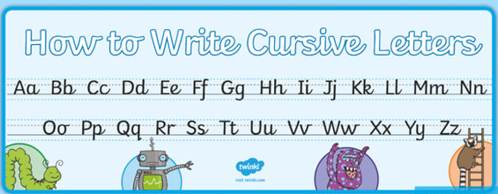
Handwriting
Cursive handwriting (also known as ‘joined up writing’) is a style of joined-up handwriting in which the letters are connected to help write faster. This is as an alternative to block letters, in which the pen lifts between every letter. Cursive style letters start from the line and are taught in families.
It is important that children hold their pencil correctly (the tripod grip) and ensure their posture is correct (feet flat on the floor, head up, not resting on the desk or hand, paper at the correct angle and spare hand steadying the paper.)
In Year 1, we will be continuing to write in ‘pre-cursive’ to help the children begin joining when they’re able to.

Slide 4
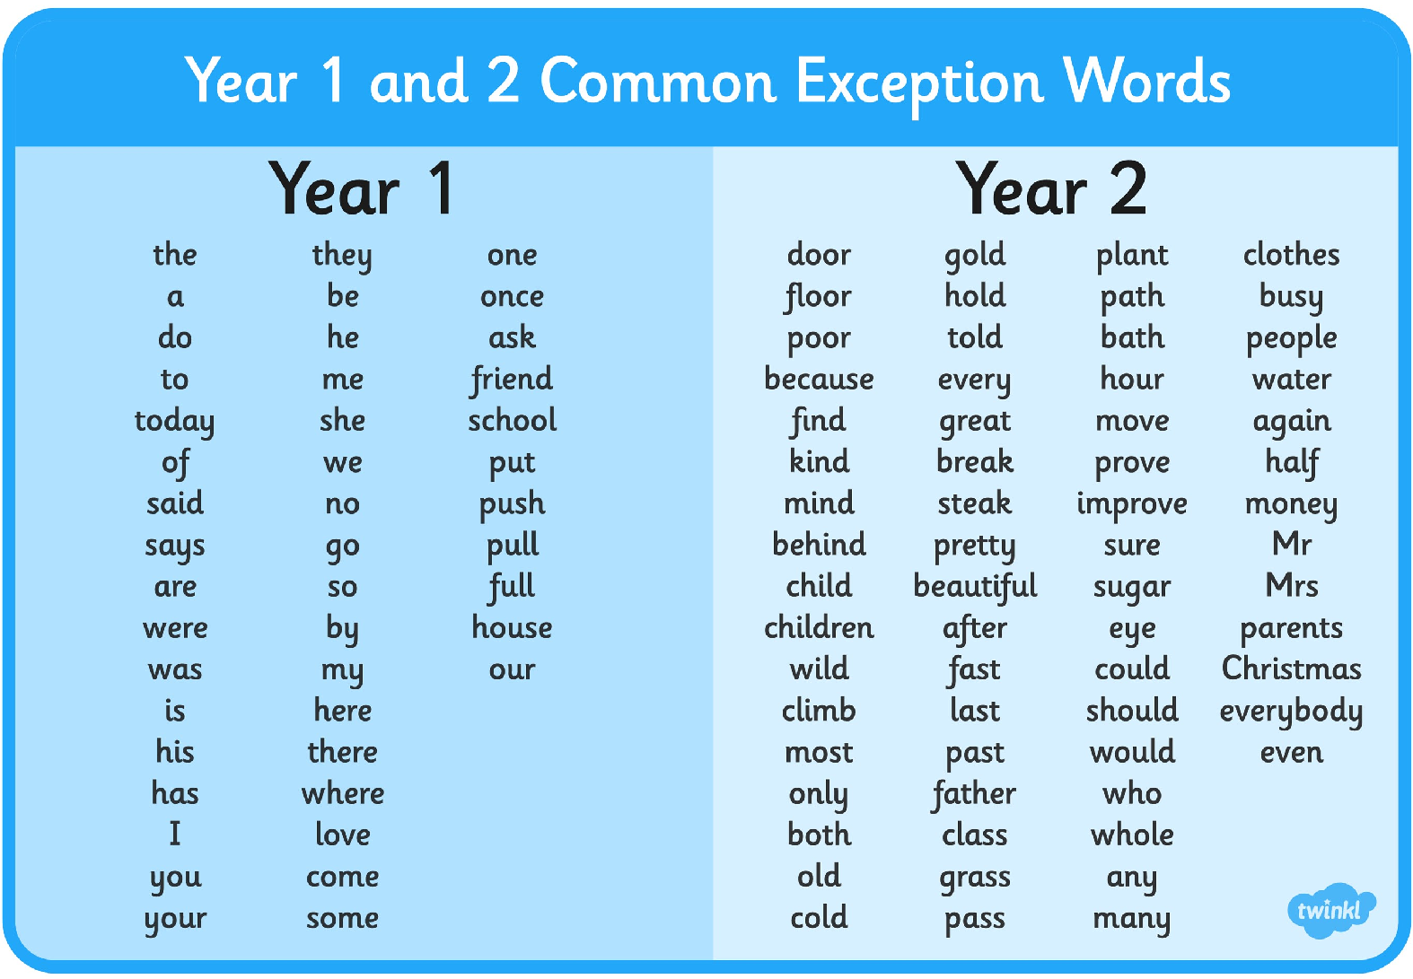
Spellings
Year 1 will be focussing on the Year 1 and 2 common exception spellings throughout the year.
We appreciate you practising these with your child at home.

Slide 5

Reading Books
In Year 1, children are expected to read to an adult every night and to have their diary signed. Our days for changing books will Thursdays and Fridays. Please ensure your child brings their book and diary into school every day so they can also read to an adult in school as well as at home.
An adult will check diaries at least once a week. Messages will be sent home if your child is not reading frequently enough. As always, we thank you for your support in this.

Slide 6
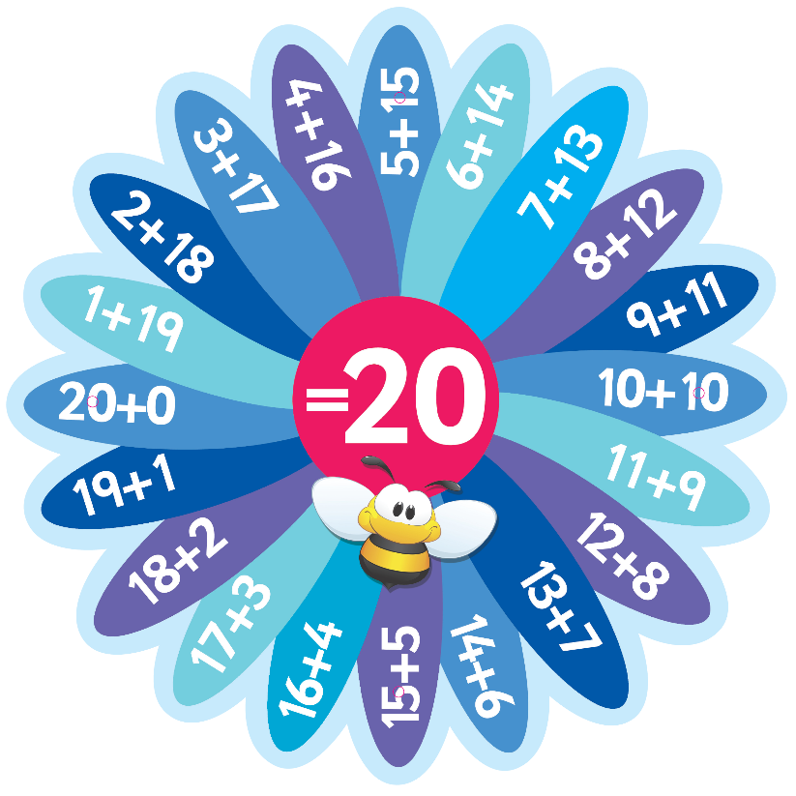

Number Bonds
Year 1 will be focussing on the number bonds to 10 and 20. As always, we appreciate you practising these with your child at home.

Slide 7

Numbots
We are encouraging children to use Numbots regularly to help build their confidence and fluency in number skills. Your child’s login has been stuck into their reading diary and we really appreciate your support in helping them access this valuable resource as often as possible.

Slide 8
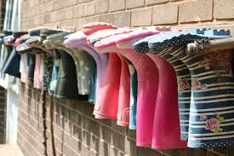
Enrichment
Year 1’s enrichment will begin the week beginning 15th September. Children will need forest school clothes on Mondays until the end of term. The class will be in two groups (one group will be cooking and the other group will work in forest school). You will receive a Class Dojo message to tell you which weeks your child needs their forest school clothes and footwear.

Slide 9
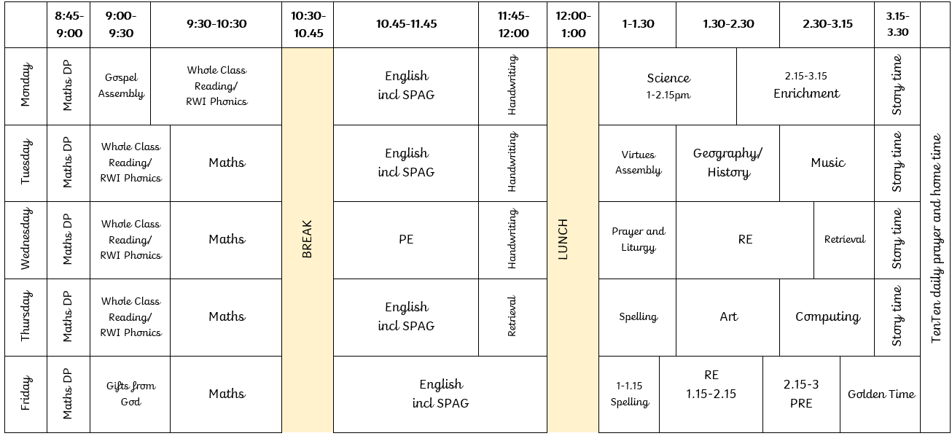
Timetable
Our timetables vary slightly on a weekly basis but generally will follow this format.
PE day = Wednesday. Please ensure your child comes dressed in their PE uniform. Enrichment = Monday

Slide 10
How Can You Help?
Reading every evening (not just home-reader books).
Asking questions about books you read or things you watch.
Practising pre-cursive handwriting (handwriting paper can be sent home).
Encouraging children to complete all homework set.
Encouraging children to maintain a positive attitude to school and learning.
Please do not hesitate to contact school if you have any questions, worries or concerns!

Slide 11

Questions?

