Slide 1
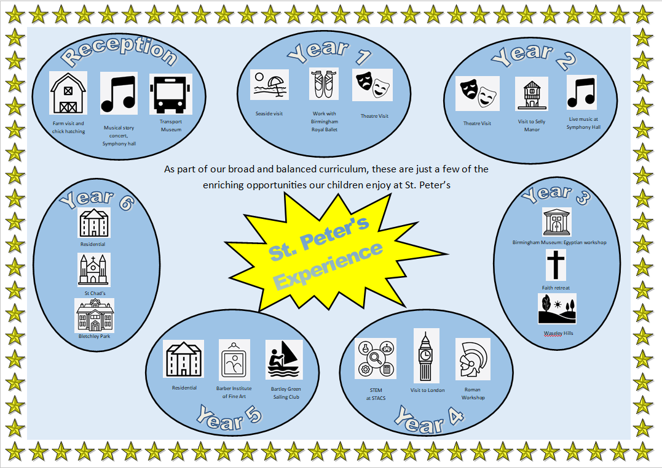


Slide 2
Whole Class Opportunities Throughout Our School- Infants
Reception | Where / What | Experience | Curriculum Links
 | Attwell Farm | Experience with animals | KW – Growing and changing
 | Chick Hatching | Watching chicks hatch | KW – Growing and changing
 | Music Visit – Symphony Hall | See a live music performance | Musical Experience
 | Forest School | Nature/engagement with risk/problem solving and team building | KW, PSED and PD
 | National Transport Museum | History of Transport | KW – Transport – Past and Present
Year 1 | Weston Super-Mare | Experience the seaside | Coast – Geography
 | Theatre Visit – The Rep | See a live theatre performance | Link to literacy text
 | Explore local area – | Local historical places of interest | Geography – local area
 | Forest School | Nature/engagement with risk/problem solving and team building | Science and RE
 | Birmingham Royal Ballet | Ballet Experience for children | PE – Dance
Year 2 | Theatre Visit – The Rep | See a live theatre performance | Link to literacy text
 | Selly Manor (local) | Local historical places of interest | Tudors - History
 | Forest School | Nature/engagement with risk/problem solving and team building | Science and RE
 | Roman Workshop | Historical event | History – Romans in Britain
 | Symphony Hall | Concert | Music

Slide 3
Whole Class Opportunities Throughout Our School- Juniors
Year 3 | Where / What | Experience | Curriculum Links
 | Birmingham Museum | Ancient Egypt & Anglo-Saxon | History – Egyptians & Anglo-Saxons
 | Waseley Hills | Nature Outdoor | Geography – Rivers
 | Forest School | Nature/engagement with risk/problem solving and team building | Science and RE
 | STACS Faith retreat | Faith Retreat | RE
Year 4 | STACS - STEM | STEM Workshops in secondary science labs | Science and DT
 | Birmingham Music Service | Learn to play an instrument | Flute lessons weekly - Music
 | London -Parliament and Thames Tour | Experience the Capital City | London and the South East – Geography Stuarts - History
 | Forest School | Nature/engagement with risk/problem solving and team building | Science and RE
 | Roman Workshop | Historical event | History Life in Ancient Rome & The Rise and Fall of Rome
Year 5 Year 6 | STACS - STEM | STEM Workshops in secondary science labs | Science and DT
 | Alton Castle/ Bell Heath | Experience a residential visit Experience a religious retreat | Catholic Retreat – RE Adventurous Activities - PE
 | Bartley Green Sailing Club | Sailing | PE, PRE Water safety
 | Birmingham Symphony Hall | Live music | Music – Birmingham Symphony Hall to see CBSO live performance
 | Barber Institute | See important works of art and museum collections | Art and History
 | Birmingham City Centre (local) | Canal barge trip | Industrial Revolution - History
 | Forest School | Nature/engagement with risk/problem solving and team building Learning how to ride safely on the roads and in the community | Science and RE
 | Bike Ability | Learning how to ride safely on the roads and in the community | PE, RHE and safeguarding
 | Bletchley Park | Visit important landmark/Historical Building | WW2 – History
 | Alton Castle/ Bell Heath | Experience a residential visit Experience a religious retreat | Catholic Retreat – RE Adventurous Activities - PE
 | St Chad’s Cathedral | Tour of the Cathedral | R.E
 | Forest School | Nature/engagement with risk/problem solving and team building | Science and RE
 | Bike Ability | Learning how to ride safely on the roads and in the community | PE, RHE and safeguarding
 | Harvington Hall | Priest Hides/ holes | R.E/ History

Slide 4
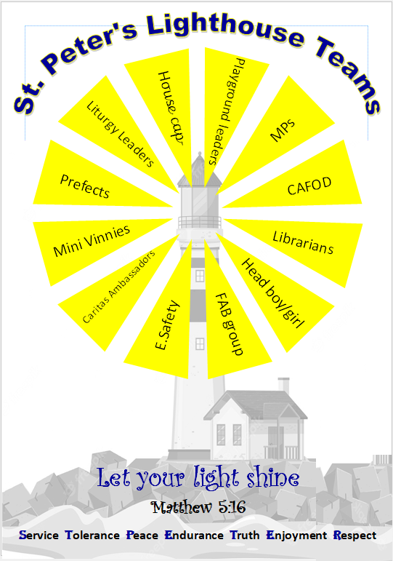
Servant Leadership
Playground Leaders | MPs | CAFOD
Organising playground games and clubs for children | Class elections for MP representative- have any ideas? Let them know! | Putting Catholic Social Teachings into action- caring for the world and society
Head Boy/Girl | FAB Group | E.Safety
represent the school and serve as a good role model for students | Be a great friend, a buddy to someone, look out for others | Keeping us safe online and in the digital world
Mini Vinnies | Prefects | Liturgy Leaders
members of the St Vincent de Paul Society (SVP), dedicated to tackling poverty | Elected to carry out certain responsibilities in school | work with the adults to enhance the school's liturgical and prayer life. Some of their key responsibilities include: Organising and leading class liturgies and prayer services
Librarians | Caritas Ambassadors | House Captains
Keeping the school library, tidy and in good order for children to enjoy reading | bring love into action in the local community. | House point collection and announcement of house points in celebration assembly

